Slide 1
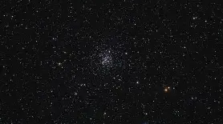
Estimating the age of M67 using Gaia data and a Color-Magnitude Diagram
Adam Johnson
Independent Research Project
Carboni, Noel, and Greg Parker. APOD: 2007 august 9 - Star Cluster Messier 67. 9 Aug. 2007.

Slide 2
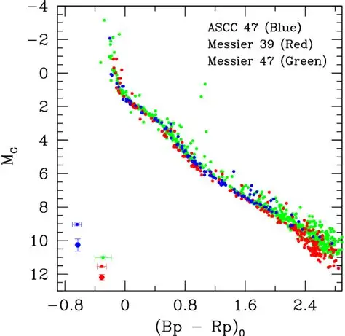

Initial Research Question: Can the age of the star cluster M67 be estimated using a color-magnitude diagram (CMD) by identifying the main sequence turnoff?
What is a CMD?
-A CMD is a diagram that represents stars by comparing their brightness vs. color
-Absolute magnitude (M) is often used to represent how bright a star is at 10 parsecs, while the stars color ${\left(Bp−Rp\right)}_{Ω}$represents how hot the star is. In this project, I used Gaia G magnitude ($M_{G}$) as the brightness measurement.
-The Y-Axis ($M_{G}$) has dim stars at the bottom and bright stars at the top
-The X-Axis ${\left(Bp−Rp\right)}_{Ω}$ has hotter stars on the left and cooler stars on the right
Intermediate-Mass Stars Become Magnetic White Dwarfs - Scientific Figure on ResearchGate. Available from: https://www.researchgate.net/figure/Gaia-color-magnitude-diagram-for-the-three-clusters-The-WDs-can-be-seen-in-the-lower_fig2_344169640 [accessed 20 May 2026]

Slide 3
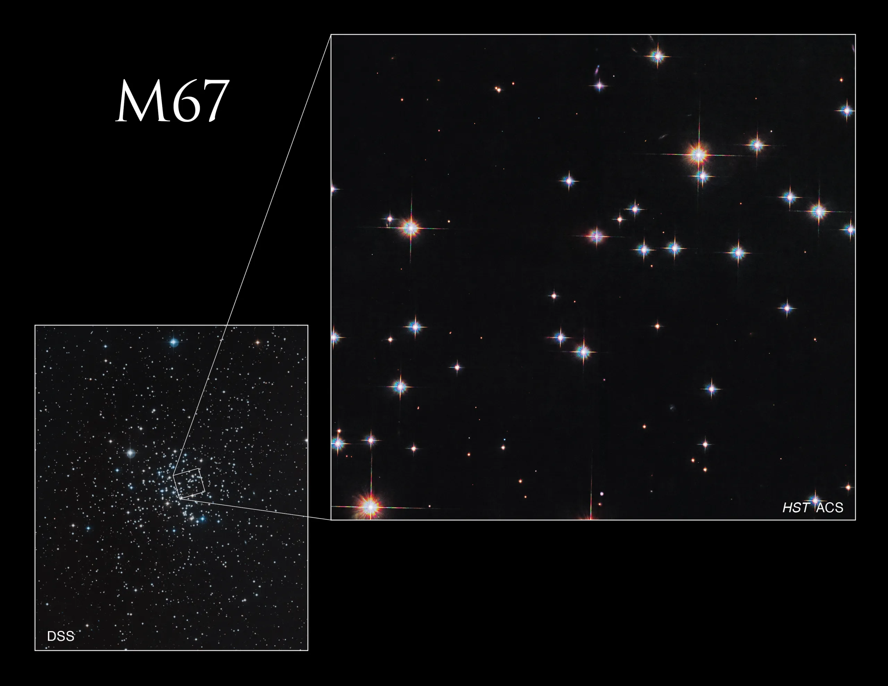
What is a Star Cluster, and Why Are CMDs Useful?
-A star cluster is a group of stars that formed from the same nebula. This means the stars often have similar ages, distances from Earth, and chemical compositions, but their masses can differ.
- CMDs are useful for studying star clusters because they show how stars are distributed by brightness and color. This makes it easier to identify features like the main sequence, locate the main sequence turnoff point, and estimate the cluster’s age.
“Messier 67 - NASA Science.” NASA, NASA, 25 Mar. 2025, science.nasa.gov/mission/hubble/science/explore-the-night-sky/hubble-messier-catalog/messier-67/.

Slide 4
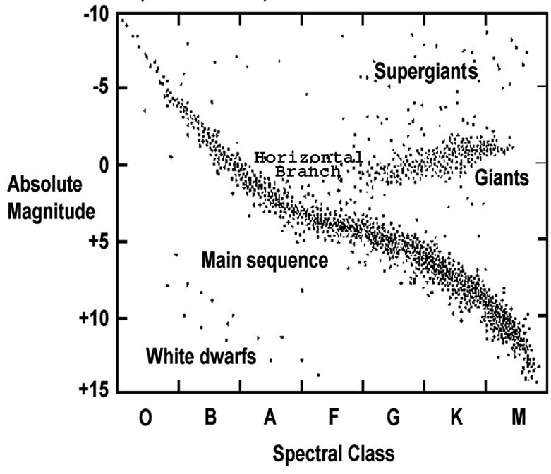
How to Read a CMD
“Age of Star Clusters & Red Giants.” Angles and Acid, www.anglesandacid.com/age-of-star-clusters--red-giants.html. Accessed 26 May 2026.
Stars on a CMD can be categorized based on their position. The major regions are:
1. Main sequence- The main sequence is where a star spends the majority of its life. At this stage, stars are actively using hydrogen fusion to create helium in their cores.
2. Giants- These are stars that have left the main sequence and expanded, becoming larger and therefore brighter. They are often cooler than main sequence stars, so many appear red or orange.
3. Supergiants- Extremely large and evolved stars. Their color can vary based on temperature, and they usually have shorter lifetimes compared to lower-mass stars.
4. White Dwarfs- These are leftover cores of low- or medium-mass stars and are no longer going through normal fusion. They are very hot but dim because of their small surface area.
Turnoff Point- This is the region where stars start to leave the main sequence after using up much of their core hydrogen. More massive stars leave the main sequence earlier because they burn through fuel faster than lower-mass stars.
Keys to Determining a Star Cluster’s Age
-A star cluster’s age can be estimated using the main sequence turnoff point. Younger clusters have hotter, brighter, and bluer turnoffs, while older clusters have lower, redder turnoffs. This happens because massive stars burn through core hydrogen faster and leave the main sequence earlier.

Slide 5
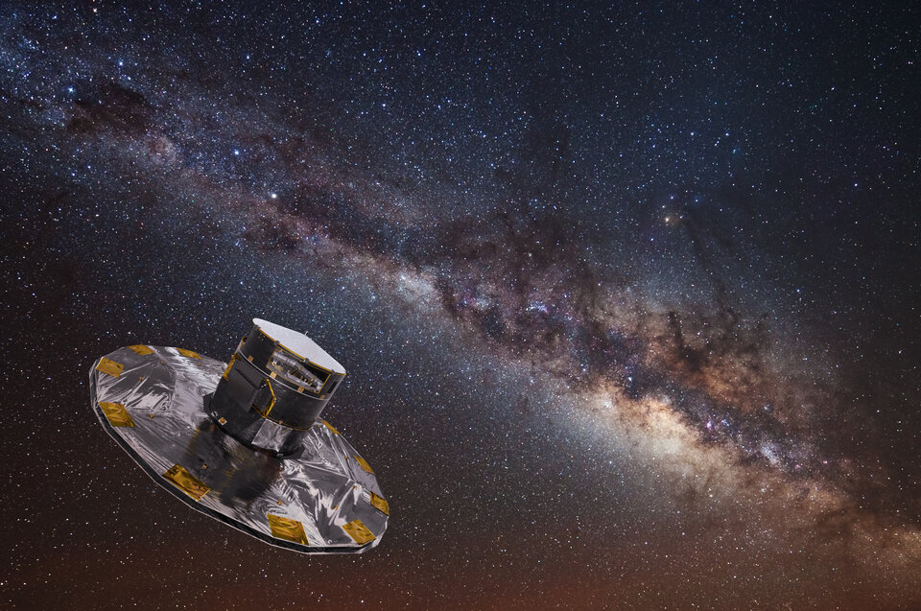
Gaia telescope and M67 star cluster
-Gaia is a space observatory operated by the European Space Agency (ESA), and its data are publicly available. The ESA describes Gaia’s mission as follows: “A global space astrometry mission, Gaia built the largest, most precise three-dimensional map of our Galaxy by surveying nearly two billion objects.”
- Messier 67 (M67) is one of the older and most well-studied open star clusters. It was first recorded in 1779 by Johann Gottfried Koehler. M67 is around 2,800 light-years away from Earth and contains several hundred known stars. M67 is especially well known because its age is similar to that of our own Sun, at around 4 billion years old.
“Gaia Overview.” ESA, www.esa.int/Science_Exploration/Space_Science/Gaia_overview. Accessed 26 May 2026.

Slide 6
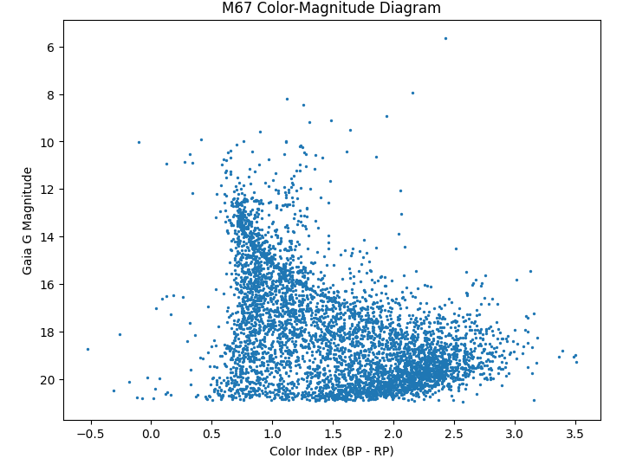
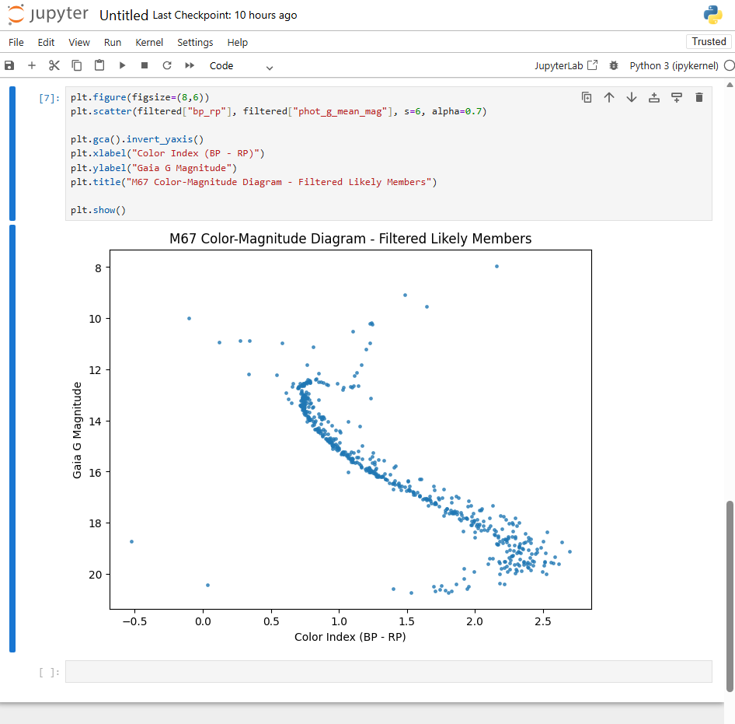
Extracting and Filtering Gaia Data
Unfiltered
-The original Gaia query returned many stars near M67, but not all were actual cluster members. Some were foreground or background stars that only appear near M67 from Earth’s point of view. To reduce this contamination, I filtered the data using sky radius, parallax, and proper motion. Sky radius selected stars near M67’s location, parallax helped select stars near M67’s distance, and proper motion helped select stars moving similarly across the sky.
-After filtering, the CMD became easier to interpret because the main sequence and possible turnoff region were clearer. I completed the filtering and visualization in Python using pandas for data handling and matplotlib for plotting. Comparing the unfiltered and filtered graphs showed how important data cleaning is when working with real astronomical data.
Filtered

Slide 7
Identifying the Main Sequence Turnoff
-The main sequence turnoff is a useful way to estimate the age of a star cluster because its location changes as the cluster evolves.
-The lower and redder position of M67’s main sequence turnoff suggests that it is an older cluster. In younger clusters, massive blue stars are still on the main sequence. In older clusters like M67, many of the more massive stars have already used up much of their core hydrogen and evolved away from the main sequence.
-Key idea: Younger clusters have hotter, brighter turnoff points. Older clusters have cooler, dimmer turnoff points.
Key
A = Turnoff Point
B = Main Sequence
C = Giants/Supergiants
D = White Dwarfs
D
A
B
C

Slide 8
Final Age Estimate of M67
-The filtered CMD supports M67’s classification as an older open cluster. The main sequence turnoff appears lower and redder instead of high and blue, which suggests that many of the cluster’s more massive stars have already used up much of their core hydrogen and evolved away from the main sequence.
-This pattern is consistent with M67’s commonly reported age of about 4 billion years, which is similar to the age of our Sun.
-Since this project used a visual turnoff estimate rather than full isochrone fitting, the age should be treated as an approximate estimate rather than an exact measurement.
-

Slide 9
What I Learned and Limitations
What I Learned
-Learned how CMDs connect to stellar evolution and star cluster age
-Worked with public Gaia data to build a research-style project
-Used Python, pandas, and matplotlib for data analysis and visualization
-Practiced cleaning real astronomical data using parallax and proper motion
-Learned how to identify the main sequence and turnoff region
Limitations and Future Improvements
-Used Gaia apparent G magnitude instead of fully corrected absolute magnitude
-Some foreground/background stars may remain after filtering
-Turnoff region was estimated visually, so the age estimate is approximate
-A stronger version would use stricter membership filtering
-Future work could compare the CMD to theoretical isochrones for a more accurate age estimate

Slide 10
Bibliography
Gaia / Data Sources European Space Agency. “Gaia Overview.” ESA Science & Exploration. Accessed 26 May 2026. European Space Agency. “Gaia Archive.” ESA Gaia Archive. Accessed 26 May 2026.
M67 / Star Cluster Sources Carboni, Noel, and Greg Parker. “APOD: 2007 August 9 — Star Cluster Messier 67.” NASA Astronomy Picture of the Day, 9 Aug. 2007. “Messier 67.” NASA Science, NASA, 25 Mar. 2025. “Age of Star Clusters & Red Giants.” Angles and Acid. Accessed 26 May 2026.
Diagram / Image Sources “Intermediate-Mass Stars Become Magnetic White Dwarfs.” ResearchGate. Accessed 20 May 2026.

